Slide 1
Wassara Explorer – a borehole surveying gyro from LKAB Wassara
Johan Knöös, Northern Europe Area Manager
LKAB Wassara

Slide 2
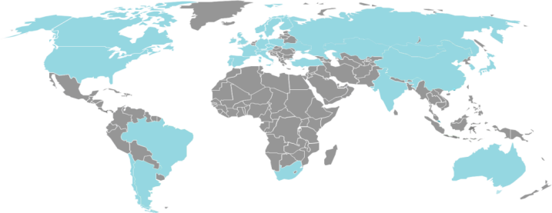


LKAB Wassara AB
Existing markets
LKAB Wassara AB - 70 Anställda
- HQ i Stockholm och Borrtekniskt Center i Malmberget
- Distributörer i c:a 28 länder
- 10 Globala Patent
- Dotterbolag till LKAB
- 4 400 Anställda
- Världsledande på underjordsbrytning
- 90% av EU’s produktion av järnmalm
Notes:
Wassara is a 100 % owned subsidiary of LKAB of Sweden, a state-owned iron ore mining company, considered to be in the forefront of mechanization and automation, a world leader in underground mining and the second largest producer of iron products (mainly pellets and fines). LKAB started to refine the concept of water-powered ITH in the early 1990´s and since 1995 all the production drilling is done with Wassara water-powered ITH-system. Since then LKAB has drilled more than 19 million meters.

Slide 3
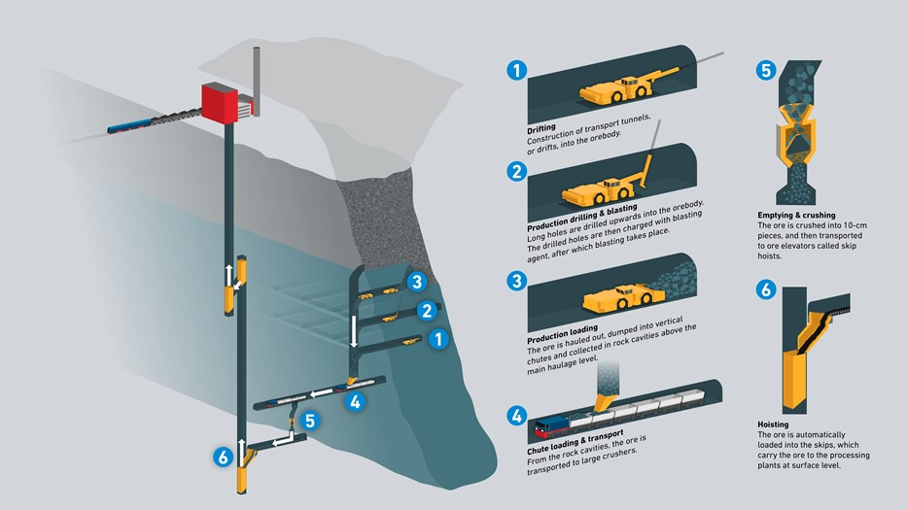
Background – Sub level caving in LKAB

Slide 4

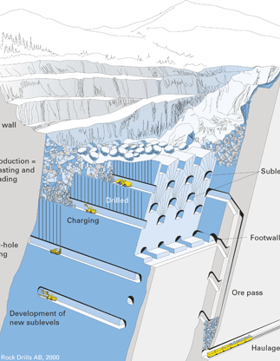
LKAB mining Yesterday vs Today
Sub-level caving

Slide 5
Result of scaling up
Before
  12 m distance between levels
  28 m bore hole length
  1 200 tons per blast
After
  28 m distance between levels
  56 m bore hole length
  10 000 tons per blast
Results
  Reduction of sublevels by 70%
  Volume per drilled meter increased by 500%
Notes:
This resulted going from 1200tons per blast to 10’000 tons per blast.
Reduction of 70% of the sublevels (tunnels)
Resulting in 500% more volume per drilled meter.
This change of drilling technology made it possible to go into large scale mining changing the entire mining process flow. Resulting in a production cost today of ~50% compared to the old way of mining making it possible to compete against the large open pit mines .

Slide 6
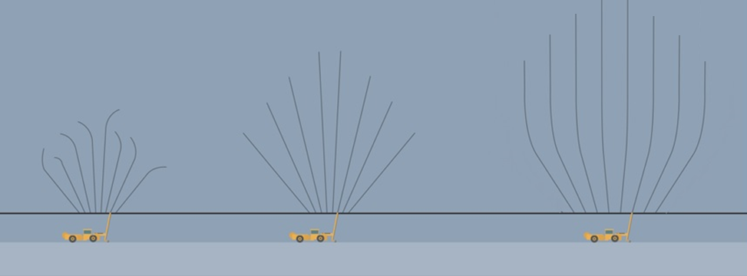

Controlled directional drilling with coiled tubing technology
Controlled directional drilling with coiled tubing
(55+ m)
Top-hammer
(28 m)
Wassara DTH-hammer
(55 m)
”Yesterday”
”Today”
”Future drilling system”
Increased efficiency and improved fragmentation

Slide 7
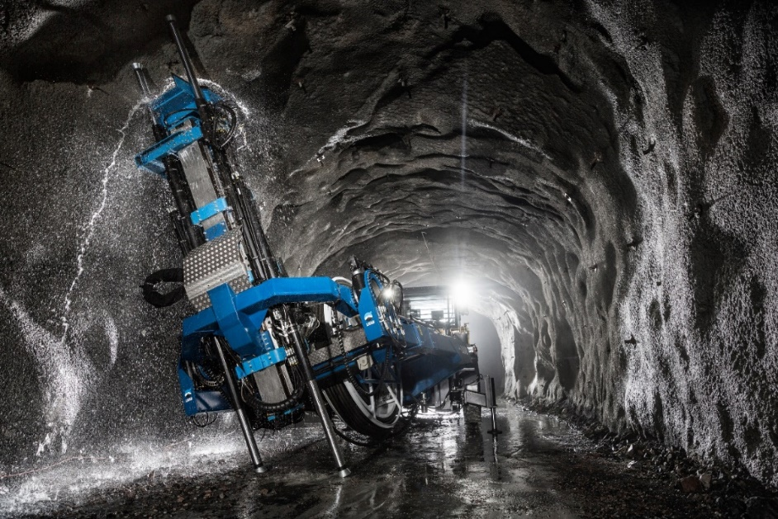
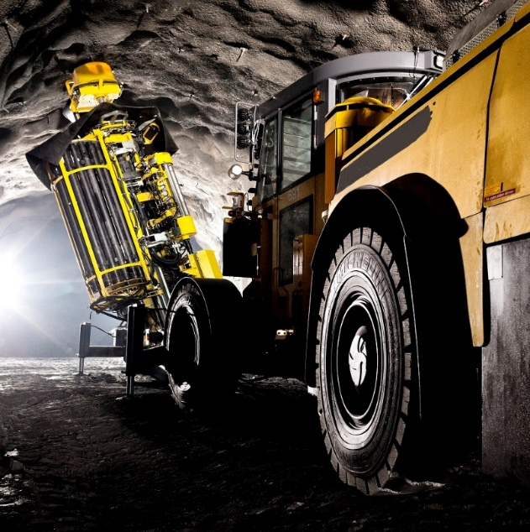
Production drilling comparison
Production drilling today
Future Drilling system
2 m rods → 20+20 shifts (40m hole)
Seamless drilling (150 m coil on reel)
Possibility to improve production drilling by over 25 % with seamless drilling

Slide 8
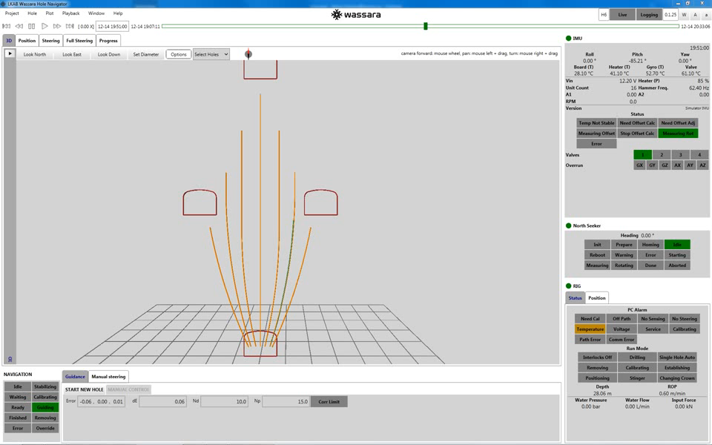
Navigation of holes

Slide 9
Revolutionary benefits
Controlled directional drilling allows for a completely new way of performing mining of ore which gives LKAB a major competitive edge:
A large potential for increasing the yield by consistent fragmentation of the ore
The draw flow can be optimized based on the ore body
geometry resulting in a reduced amount of waste rock when blasting. This contributes to increased iron ore recovery.
Eliminating rod handling contributes to a more efficient
drilling system
The amount of explosives can be minimized, reducing the environmental impact

Slide 10

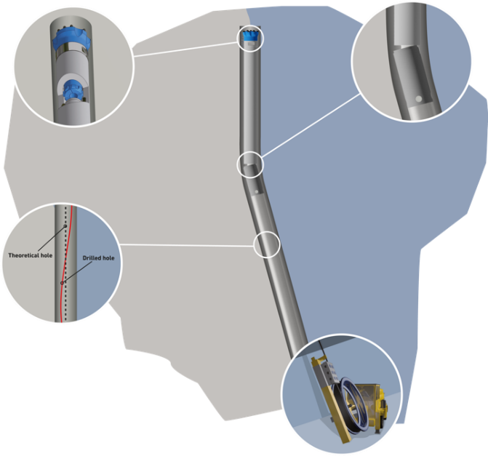


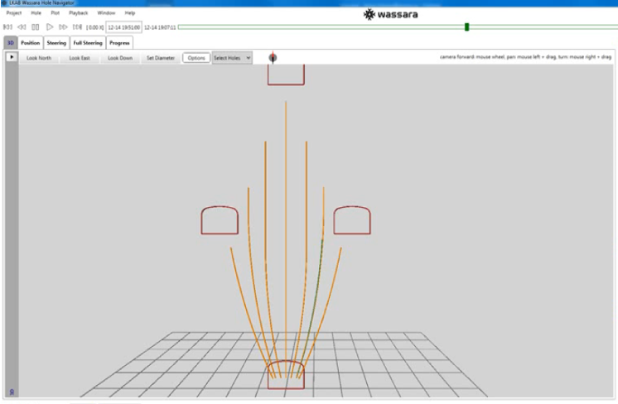
Future drilling system
STEERING
ROTATIONAL HAMMER
HOLE NAVIGATOR
POSITIONING
Direct information to:
Production charging
Possibility to improve:
Production planning
Production drilling
COILED TUBING RIG
Data from production drilling

Slide 11
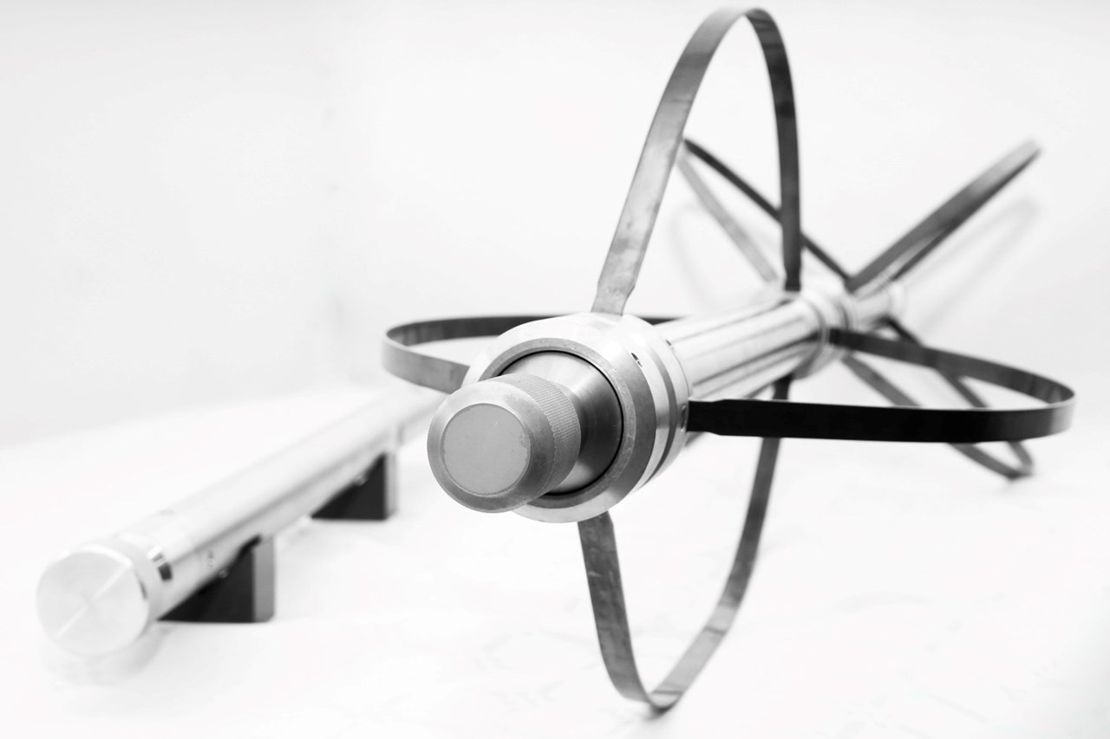
Wassara EXPLORER™
Surveying tool for borehole surveys in all formations and inclinations.
Notes:
This is what a Wassara Gyro Kit looks like complete with V-blocks, winch, tripod and excentric weight rods. Variations and accessories for blast holes, pumping inside drill rods etc exist.

Slide 12
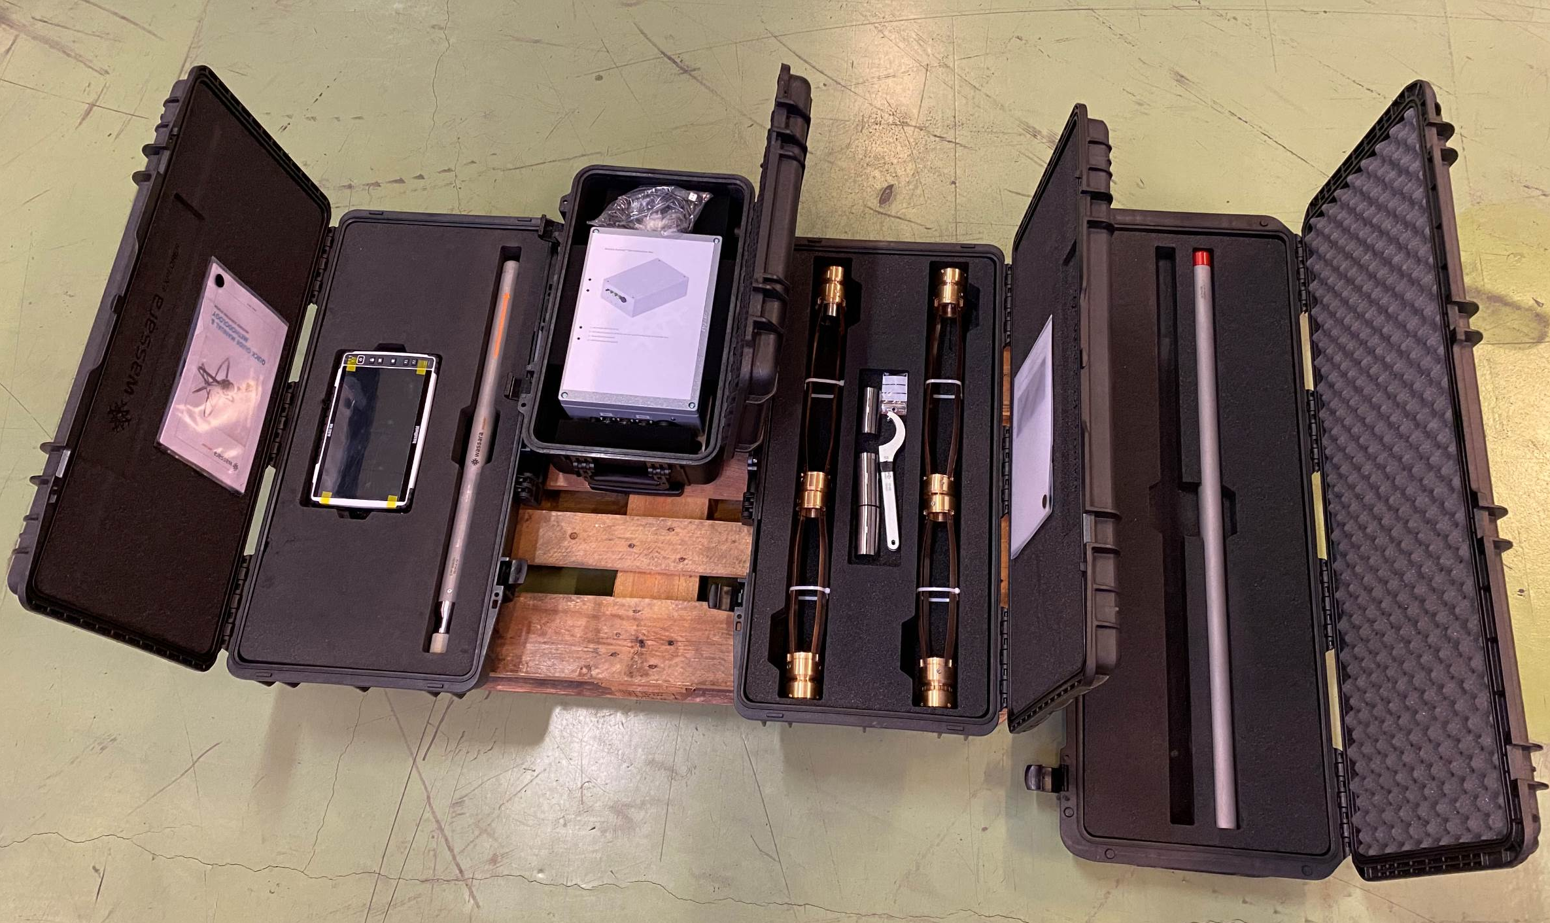
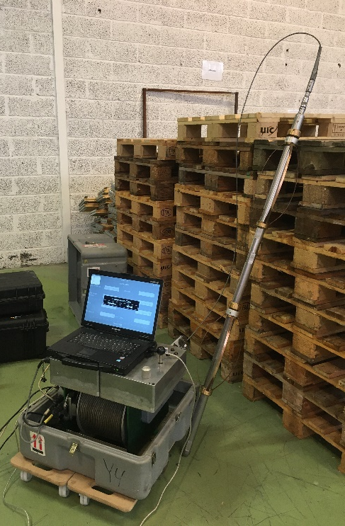
Wassara EXPLORER™ KITS
Ø25 Wire
Ø40 Wire, Battery
Live or memory mode capable tool
Dedicated custom-made software.
Field processed and QC-ed data.
Windows PC.
Non magnetic centralisers.
Eccentric no-roll weight rods.
+ other accessories.
Slim version available (25mm ø)

Slide 13
WASSARA EXPLORER™ – ACCURACY
Accuracy(%)
Inclination
Azimuth
Probe Diameters
Data Modes
Technology
Repeatability
Wassara Explorer
0,24 % (<2.4m/1000)
+/- 0.1º
+/- 0.5º
40mm / 25mm
Live / Offline
MEMS
2 sigma
By delivering excellent repeatability and positional accuracy, the Explorer™
can be relied upon when surveying deep holes at any inclination.

Slide 14
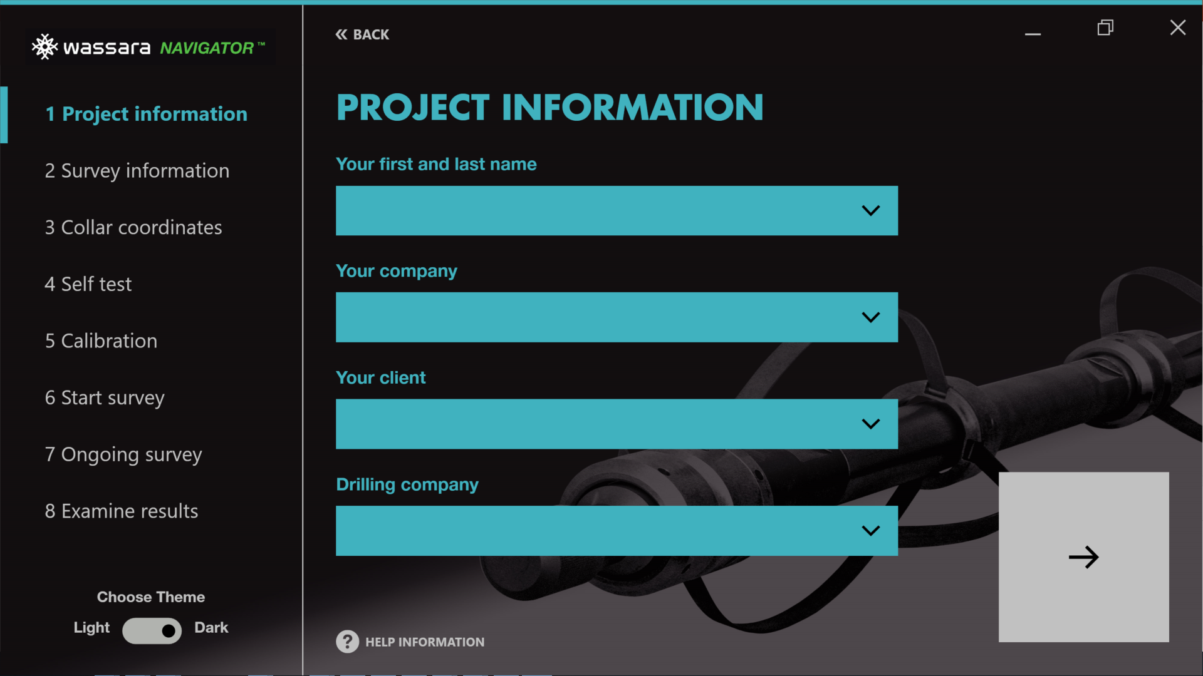
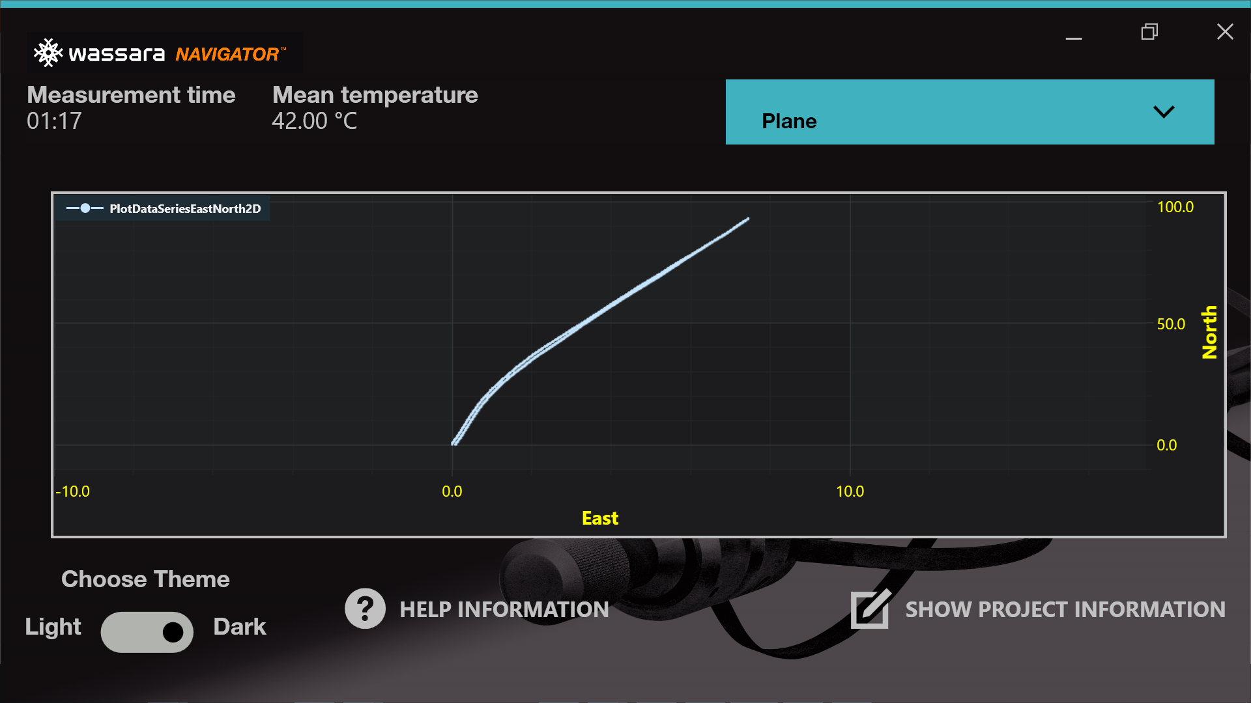
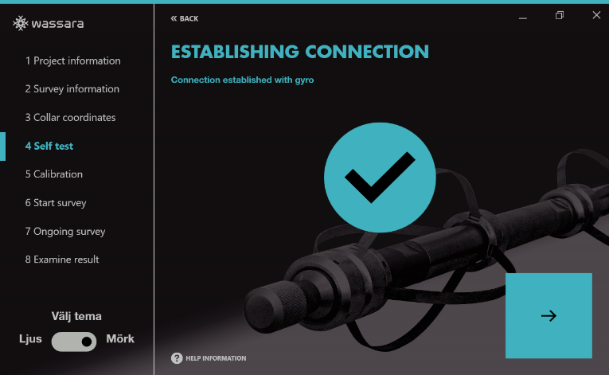
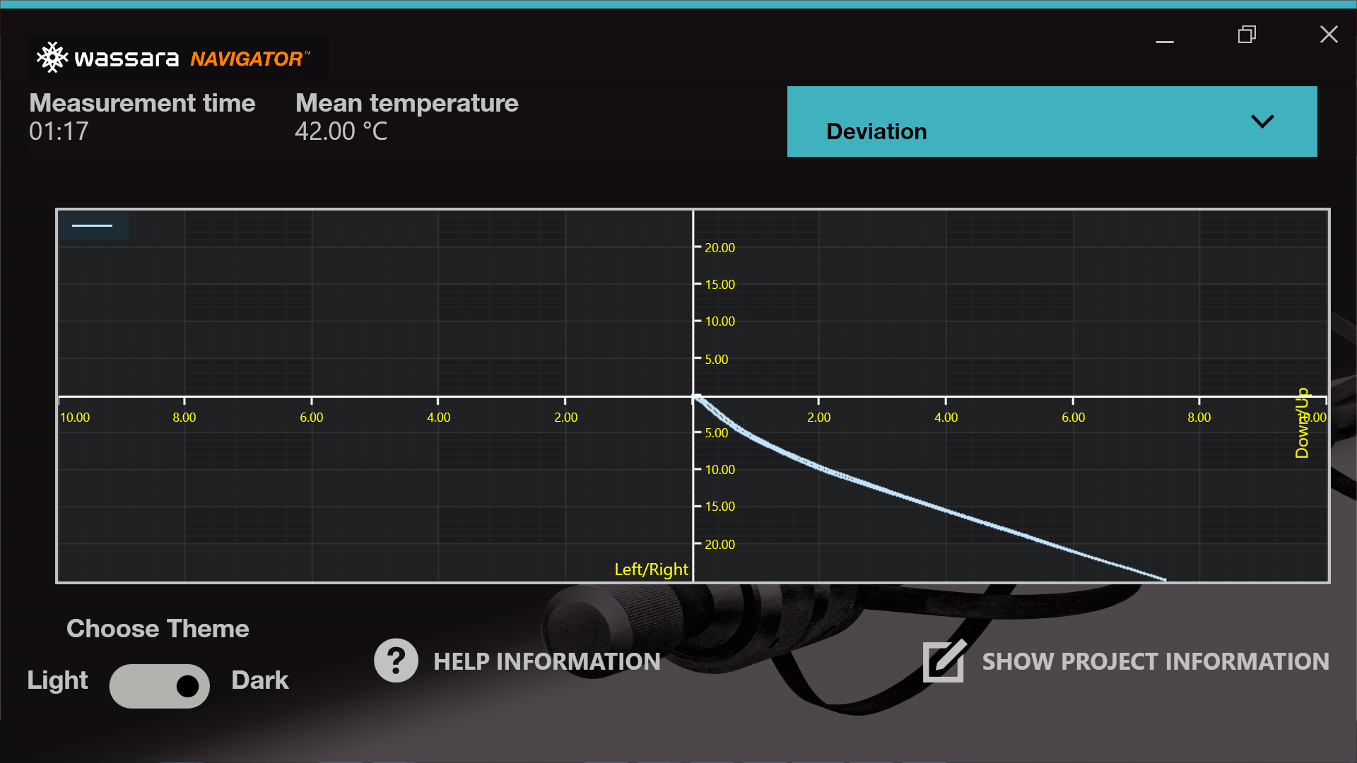
Wassara NAVIGATOR™
User-friendly, intuitive software.
Step-by-step flow wizard styled.
LIVE data for wired models.
Plan, Perspective, Deviation Views
Raw Data + Custom Plots
Subsampling to desired interval.
Excel or .data export files and reports
Single hole or fan-pattern capable.

Slide 15
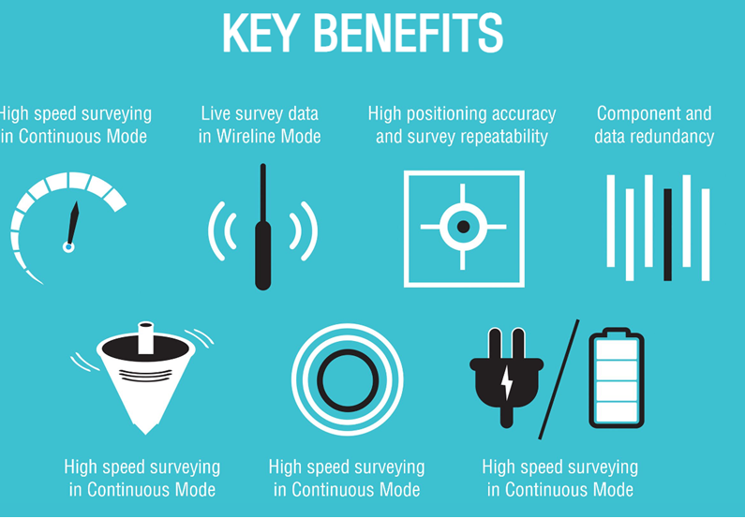

Slide 16
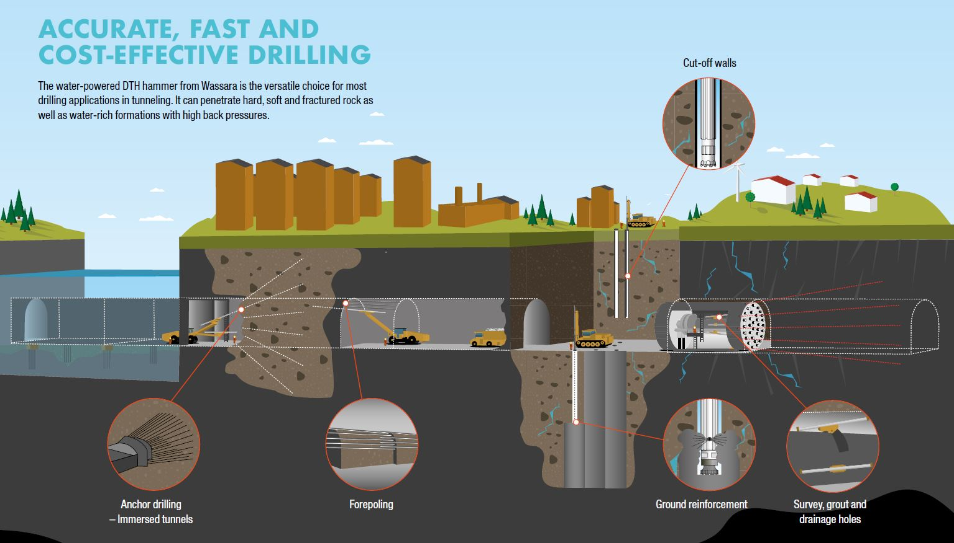

Slide 17
